Slide 1

SELENIUM

Slide 2
SELENIUM
Selenium is one of the most widely used open source Web UI (User Interface) automation testing suite
It is a free (open-source) automated testing framework used to validate web applications across different browsers and platforms
Testing done using the Selenium testing tool is usually referred to as Selenium Testing

Slide 3
Components of selenium
Selenium is not just a single tool but a suite of software,
Selenium Integrated Development Environment (IDE)
Selenium Remote Control (RC)
Web Driver
Selenium Grid

Slide 4
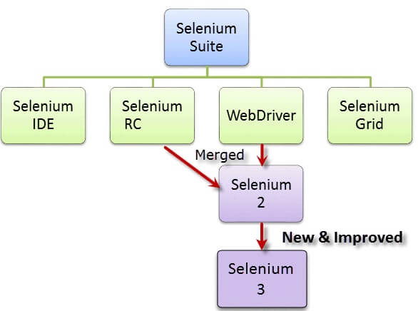
Components of selenium

Slide 5
Selenium Features
Selenium is an open source and portable Web testing Framework.
Selenium IDE provides a playback and record feature for authorising tests without the need to learn a test scripting language.
Selenium supports various operating systems, browsers and programming languages. Following is the list:
Programming Languages: C#, Java, Python, PHP, Ruby, Perl, and JavaScript
Operating Systems: Android, iOS, Windows, Linux, Mac, Solaris.
Browsers: Google Chrome, Mozilla Firefox, Internet Explorer, Edge, Opera, Safari, etc.
It also supports parallel test execution which reduces time and increases the efficiency of tests.
Selenium can be integrated with frameworks like Ant and Maven for source code compilation.

Slide 6
Selenium IDE
Selenium IDE (Integrated development environment) is an easy to use Selenium component. It is using record and playback mechanism .means we can record the actions /test cases and later play back to verify the same.
Previously Selenium IDE supports only Firefox browser. is only a Firefox plugin. after version 55 Firefox stops supporting IDE. later revamped and come back again in 2018 with Chrome and Firefox extension

Slide 7
SELENIUM IDE FEATURES
Speed Control -can control the speed of test cases run .
Run All/Run-> Run All can execute entire test suite together ,whereas Run, runs the currently selected test case.
Pause/Resume- user can pause/resume test case execution.
Steps -can step to each command in expression
Export -can be able to export text script to Selenium supported languages with framework(Java,c#,Etc.....)

Slide 8
SELENIUM IDE ADVANTAGES
Recording feature based on browser interactions.
Test case can be reused using run command .
Execution based on selence command .
Can set breakpoint.
Flexibility to run Test cases .
Can use for quick testing of bug/ defect scenarios.
Can export test case to multiple programming language.

Slide 9
LIMITATIONS OF SELENIUM IDE
Cannot be able to handle dynamic web applications.
Don't have feature of test results generations and screenshot capture .
Cannot be able to connect with the database .
Extensive data testing not possible.

Slide 10
SELEnIUM Selenese COMMANDS
Action- used for change the state of application (Eg.click,Type,Select).
Accessors- Enable verification and storage of the application (Eg.text present -it will store true /false based on text presence)eg;store,store text, store title.
Assertions- used for comparing actual and expected result .if the both are equal then only test case passed (Eg.Verify Text) 3 modes of assertions– Assert,verify&waitFor.

Slide 11
differences between Assert and Verify
Assert | Verify
Verifies if the specified condition is true and false. If the result is true, the next test step will be executed. In case of false condition, the execution would terminate. | Verifies if the specified condition is true and false. If the result is true, the next test step will be executed. In case of false condition, the execution would still continue.
In case of false condition, the next test case of the suite will be executed. | In case of false condition, the next test step of the same test case will continue.
There are two types of assets namely hard and soft asserts. | There are no categories for verification.

Slide 12
